Slide 1

DAB 301 Project
CONFIDENTIAL INFORMATION MANAGEMENT PLAN (CIMP)

Slide 2




INTRODUCTION
Clients across Industries
Projects in every domain
Data from various streams

Slide 3




PROJECT MOTIVATION
Loss of Business
Loss of Competitive Edge
Criminal Activity

Slide 4

PHASE 1: CI RISK ANALYSIS & CONTROL

Slide 5


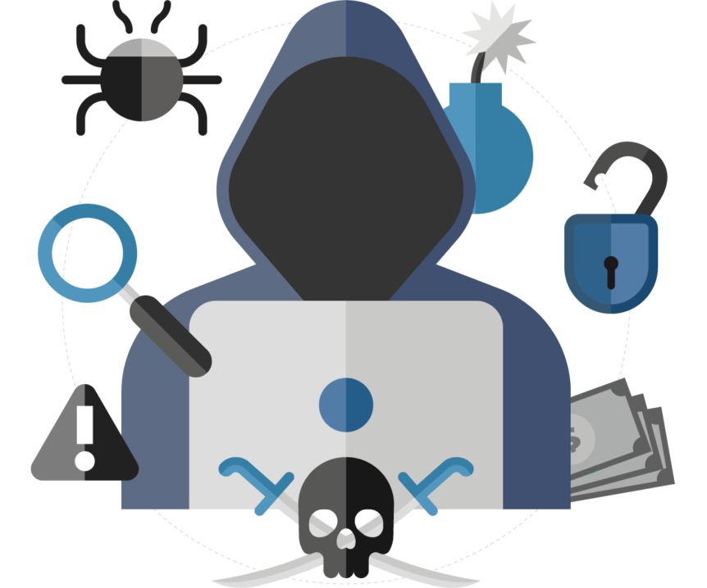

RISK ANALYIS & CONTROL
RISK ANALYSIS
QUALITATIVE
QUANTITATIVE
SAFEGAURD MEASURES
INDUSTRY SPECIFIC
FUNCTION SPECIFIC
JOB ROLE SPECIFIC
BREACH MITIGATION POLICIES
CIMP COMPILATION AND DOCUMENTATION
RISK ANALYSIS
QUALITATIVE
QUANTITATIVE

Slide 6
PHASE 2: TRAINING COURSE

Slide 7



CIMP TRAINING COURSE
Planning Training Content
Shooting and Editing Training Video
Finalizing Content and Structure

Slide 8



CIMP TRAINING COURSE
Training Reinforcement
Training Completion
CIMP Acknowledgement

Slide 9
PHASE 3: CIMP ROLLOUT

Slide 10



Phases of cimp rollout
Appointment of Data Compliance Officer
Training Verification
Completion Report

Slide 11
PROJECT OUTCOME

Slide 12






Project outcome
Raise Awareness
Robust Framework
Compliance
Prevent Loses
Builds Trust

Slide 13
PROJECT LIFE CYCLE

Slide 14





PROJECT LIFE CYCLE
Project Initiation
Phase 1
Phase 2
Phase 3
Project Closing
Business Case
Project Charter
Stakeholder Register
Project Budget
Requirement Gathering
WBS
Resource Activity Chart
Communica-tion Plan
Change Request
Change Log
RACI Matrix
Lessons Learnt

Slide 15

Thank You
Siddhartha patra (0787887)
Diksha (0794012)
Siddharth Rajguru (0801075)
Preet Patel (0795875)
Usama norat (0792225)

